Slide 1
Kno2 Brand Guidelines DO NOT EDIT THIS VERSION
Updated: June 2023

Slide 2
When Kno2’s Communication API is made available through an integrated experience or application, that technology becomes “Kno2 Connected”.
The “Kno2 Connected™” phrase is used in all public communications and marketing content, including, but not limited to brochures, videos, social media posts, advertisements, webinars, public communications, etc.
The “Kno2 Connected” phrase may be converted to “connected by Kno2” to fit better into a sentence grammatically.

Slide 3


Kno2 Primary Logo
Number of Controls: 242
Reservation Date:
Logo Clear Space
The minimum clear space defines a buffer zone for the Kno2 logo to ensure legibility, readability and recognition. No other graphic element is to violate or crown the minimum clear space.
Logo minimum size
The minimum size specifications ensure that the logo is always legible. Remember to maintain the correct aspect ratio when scaling the logo.
Minimum size (in print) is 1 inch with clear space
Minimum size (on screen) is 120x
Minimum clear space

Slide 4
This paragraph describing Kno2 will be used in all press releases and public announcements.
We encourage our partners to announce their relationship with Kno2 to help promote the use of the integrated solution to propel interoperability forward for the entire healthcare industry.
BOILERPLATE
ABOUT KNO2
The Kno2 network enables the secure, effortless, and maximized exchange of patient information across patients, providers, payers and IT vendors. We are empowering healthcare to finally realize the true potential of interoperability by unleashing connectivity everywhere through a simple to use Communication API and robust tools for any business. With industry disrupting economics and our passion to include the underserved, Kno2 is democratizing healthcare communications and defining the new connected future of healthcare. With a single connection to Kno2, anyone can quickly gain access to a powerful network of connected networks, EHRs, organizations, technologies and interoperability frameworks that gives the freedom to easily communicate with all. To learn more, visit www.kno2.com.

Slide 5

Kno2 democratizes healthcare communication for all, enabling the secure, effortless, and maximized exchange of patient information.
PURPOSE

Slide 6
Color Palette: Accent
General Logo Specifications
The Kno2 icon/mark uses a trio of blue with overlapping gradience. The Kno2 logo color palette identifies the predominant colors.
Top Triangle
R25 G167 B222
HEX #19a7de
C89 M25 Y0 K13
Middle Triangle
R0 G86 B151
HEX #005697
C100 M43 Y0 K41
Bottom Triangle
R11 G125 B194
HEX #0b7dc2
C94 M36 Y0 K24

Slide 7
Color Palette: Accent
We use color in an organized way to express the brand idea and support or emphasize messages in communications.
Accent colors are selected to work well with the primary logo colors. They are used for backgrounds and graphic elements if the primary colors are not used. We use our standout color, yellow, to invoke action (i.e. buttons).
Dark Blue
R1 G36 B142
HEX #01248E
C100 M94 Y11 K5
Medium Blue
R6 G107 B193
HEX #066BC1
C87 M58 Y0 K0
Pale Blue
R228 G243 B251
HEX #E4F3FB
C9 M0 Y0 K0
Purple
R91 G97 B246
HEX #5B61F6
C72 M66 Y0 K0
Yellow
R251 G201 B8
HEX #FBC908
C2 M20 Y100 K0
Orange
R231 G122 B60
HEX #E77A3C
C6 M64 Y87 K0

Slide 8
Brand Attribution Guidelines
Brand attribution guidelines apply to Kno2 partners.
Integration Partners may include, but are not limited to EHRs, digital health platforms, patient engagement applications, proprietary networks, as well as office technology partners where Kno2 is made available through an integrated experience or application on or within another device.
In rare instances, Kno2 contracts with organizations who become Private Label Partners.
Please refer to the appropriate brand attribution section(s) based on the partnership.
Our objectives are simple:
Brand attribution to Kno2 for the functionality
Brand attribution to our partner for creating the integrated experience using Kno2’s Communication API.
Consistent messaging to ensure Kno2 remains in good standing with the network membership organizations.
The four basic requirements for Kno2 mark still apply:
Adhering strictly to logo-color usage
Observing minimum clear space
Being aware of minimum reproduction sizes
Placing the logo or reference prominently

Slide 9
Color Palette: Support
There are three support colors: black, grey, and white. Black is generally used for body text and for text in information graphics or illustrations. Grey is typically used for subtitles and captions. White is used as a background color or to create a reverse text, which may be placed on a background made up of the primary or secondary colors.
Black
R6 G7 B7
HEX #060707
C14 M0 Y0 K97
Grey
R75 G75 B75
HEX #4B4B4B
C100 M43 Y0 K41
White
R255 G255 B255
HEX FFFFFF
C0 M0 Y0 K0

Slide 10
Brand Attribution Guidelines
KNO2

Slide 11
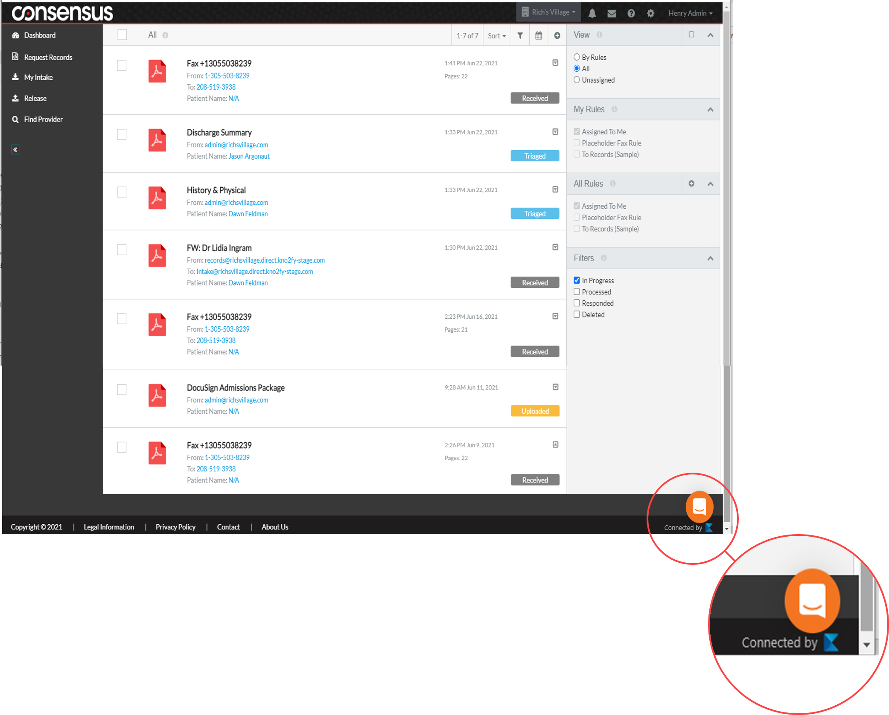

Private Label: Brand Attribution Guidelines
Additionally, the user experience must reflect the “Kno2 Connected” phrase. At a minimum, brand attribution with the Kno2 icon appears at the login prompt.

Slide 12
Editorial Guidelines
KNO2

Slide 13
Editorial
When using the Kno2 name in text, please adhere to these guidelines:
Kno2 is always one word
First reference to the Kno2® organization name needs to include the registered trademark “®” after the “2” in Kno2.
Do not abbreviate Kno2, ie. K2

Slide 14
Editorial
Messaging Tips for Partnership
<Partner> announces its partnership with Kno2®, the company leading the future of healthcare communication
“<Partner> announces its partnership with Kno2®, a purpose-driven company who is democratizing healthcare communication for all to enable the secure, effortless, and maximized exchange of patient information.”
Messaging Tips for Integrated Technology
<insert technology> is Kno2 Connected™
<insert technology> is connected by Kno2®
Messaging Tips for Private Label Partner
To ensure proper respect to each brand, attribution to Kno2 and the company’s approach to solve interoperability should be acknowledge when broached.
The Private Label Partner is free to and encouraged to:
Name the integrated product or solution
Use brand statements that lean towards what the product accomplishes

Slide 15
Kno2 Network Approved Brand Phrases
Kno2’s network enables secure, effortless, and maximized exchange of patient information.
Kno2’s network and all other networks become immediately available with just one simple, yet comprehensive, connection that gives providers the freedom to communicate with all.
Kno2’s network is connected to, and will continue to connect to, every meaningful network committed to the exchange of patient information, thus making access to the complete patient record possible, regardless of the communication preference of each provider.
Connect once to Kno2 and gain access to a powerful network of connected organizations, technologies and interoperability frameworks.

Slide 16
Brand Adherence with Network Membership Organizations
KNO2

Slide 17



Brand Adherence with Membership Networks
Integrated partners must adhere to the brand guidelines of these and any other networks the partner gains access to through the Kno2 Communication API
Kno2 is an active member of Carequality
Kno2 is an approved implementor of the Carequality Interoperability Framework.
Kno2 is an active member of CommonWell Health Alliance®
Kno2 is not a service adopter
Kno2 is an active member of DirectTrust

Slide 18
Carequality
Kno2 is an active member of Carequality Carequality governs a national-level, consensus-built, common interoperability framework to enable exchange between and among health data sharing networks.
Kno2 is an Implementer of the Carequality Framework The initial Carequality use case is Query-Based Document Exchange, allowing providers access to electronically query records and retrieve patient information on demand from other providers live on Carequality.
Reciprocity is a condition of participation Simply put, if providers want to become “initiators” and query of others to pull their information, they also must be a “responder” to the queries of others on the framework.
EHR connectivity to the framework is required For healthcare organizations to take advantage of query-based exchange, their EHR must be connected to the Carequality framework
Exceptions called out in Section 3.2.1 for provider organizations without electronic clinical information and Section 3.2.2 for emergency medical service providers with alternate data sharing methods
Resource: Carequality Query-Based Document Exchange Implementation Guide

Slide 19
Carequality
Regardless of who the Carequality Implementer the result is the same CommonWell is another implementer just like eHealth Exchange, Kno2, Epic and others. Thus, any provider who is live on the Carequality Framework and visible in the directory is also queryable.
Important Note Keep in mind, just because Epic is an Implementer on the Carequality network and Cerner is a CommonWell member company does not mean that all Epic and Cerner hospitals are participants on the network. The health system, hospital or provider office needs to enable the connectivity and agree to the terms of participation in order to go live in the directory for patient query.
For a listing of all Carequality Implementers, visit Members and Supporters – Carequality
Messaging Tips Carequality is a framework, not a network While the “e” in Carequality’s logo is italicized, it is not necessary to italicize it in plain text or web copy.
Approved marketing language “Kno2 is an Implementer of the Carequality framework that allows access to electronically query records and retrieve patient information on demand from providers live on Carequality, including those connected through athenahealth, CommonWell Health Alliance, eClinicalWorks, eHealth Exchange, Epic and others.”

Slide 20
CommonWell Health Alliance®
Kno2 is an active member of the CommonWell Health Alliance® We do not directly connect EHRs, providers or patients to this network.
CommonWell is now an Implementer of the Carequality Framework Through this connectivity, participating CommonWell member companies can offer this service to their CommonWell-enabled provider sites, allowing them to connect and bilaterally exchange health data with Carequality-enabled health care providers to improve care coordination and delivery.
Approved CommonWell marketing language “…patient information query with providers live on Carequality, including those connected through CommonWell Health Alliance”. This messaging can essentially be used with any other implementor swapped in CommonWell’s place and be accurate.

Slide 21
DirectTrust™
Kno2 is an active member of DirectTrust Therefore, we must abide by their Brand Guidelines for key phrases and proper reference in marketing media content
Resources: DirectTrust Media Kit » DirectTrust to locate up-to-date Brand Guidelines
Kno2 leverages their framework using trusted Health Information Service Providers (HISPs)

Slide 22
DirectTrust Messaging Tips
Direct Secure Messaging The proper use to comply with DirectTrust brand guidelines. Secure is a key phrase here because of the Federated Agreement each HISP has to sign to comply with the trust framework (identity proofing). Other platforms use Direct messaging, but it is not done through the Direct protocol, so this phrasing sets them apart.
Focus on adoption of the Direct Standard™ With Meaningful Use, every certified EHR, from 2014 certification and on, implement the use of Direct Secure Messaging. With over 2 Billion messages sent and received, DirectTrust the largest push-based network in healthcare.
DirectTrust Accredidation/Membership is not required to leverage the Direct Standard™ The Direct Standard is an open standard and the vast majority of those who use the standard are a part of the DirectTrust network, either through membership or the community.
DirectTrust Directory Number of Addresses reported on their website will always be larger than the number found in the DirectTrust Directory because healthcare organizations can decide whether to “publish” their addresses in the directory. Patient/Consumer addresses are currently not published in the Directory and there are currently no plans to publish.

Slide 23
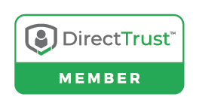
Logo Use
 | Must comply with DirectTrust brand guidelines for usage. DirectTrust Media Kit » DirectTrust | If the Kno2 integrated Partners is using the Send and Receive API, the integration is enabled with a Kno2 addresses that can leverage the Direct Standard™.
 | Issued by DirectTrust to paying members. | Kno2 Partners must be DirectTrust members and be issued their member logo by DirectTrust in order to use it.
 | Must comply with Carequality brand guidelines for usage. | If the Kno2 integrated Partner has consumed the Kno2 Find API for connection to Carequality, they can use this mark. I White Label partner may use this mark.
 | The CommonWelll Health Alliance logo can only be used by members of CommonWell. Must comply with CommonWell Health Alliance brand guidelines for usage. | Kno2 Partners who are not members of CommonWell Health Alliance cannot use this logo mark.

Slide 24
Legal Guidelines
KNO2

Slide 25
Trademarks and Copyrights
These trademark and Logo Usage and Copyright Attribution Guidelines (“Guidelines”) set forth the rules established by Kno2 LLC for users authorized to use the Kno2 trademarks, trade names, logos and slogans including its partners and Kno2 itself. Kno2 reserves the right to modify these Guidelines at its discretion. Kno2 Trademarks are an important asset to Kno2, and we require all of our partners and customers to adhere to the Guidelines when using Kno2 trademarks.
The copyright legends are the legal text that identifies Kno2 Trademarks and Kno2 copyright protected materials. The legend should be printed in legible type and in locations typically used for copyright and other legal notices. For example, the legend may be printed at the end of a document, or the back of a package, on the front cover of the documentation, or on the bottom of a web page. The size of the text used for the legend should be no smaller than 9 point.
Trademarks
The Kno2 Trademark is a registered trademark. Always use the symbol ® and place it after the number “2” in Kno2, either in superscript or in the parenthetical form such as Kno2® or Kno2 (R).
Kno2 has several other trademarks:
Kno2: Connectivity as a Service™
Kno2’s Connectivity as a Service™
Kno2 Connected™ or Connected by Kno2®
Kno2fy™
Kno2.iQ™
Copyright
Standard Kno2 Legend – The following Standard Kno2 legend for use by Kno2 on Kno2 materials:
Copyright © 20XX Kno2 LLC. All rights reserved.

Slide 26
Resource Materials
Kno2 owns all right, title, and interest, including copyright, to and in all Kno2 resource materials whether electronic or hard copy, including for example, case studies, demonstration videos and slides, overviews, guides, white papers, and webinars (collectively, the “Kno2 Resource Materials”). From time-to-time Kno2 may create and/or author additional materials and/or revise and update existing Kno2 Resource Materials.
Kno2 hereby grants to Partner, solely for its own internal business purposes (and not for resale or use with any unrelated third party), a limited, non-sub licensable, non-exclusive, right to copy and distribute the Kno2 Resource Materials electronically and in hard copy for the purpose of creating training materials for Partner employees (the “Partner Training Materials”). Partner will retain or include, as applicable, the copyright notice contained in the Partner Training Materials provided by Kno2 on all copies or derivatives thereof. Partner may not use the Kno2 Product Guide for any other purpose or in any other manner without the prior written permission of Kno2.
Partner acknowledges and agrees that (a) the Kno2 Resource Materials contain information and instructions regarding the proper operation of Kno2 Products and services, and (b) that any alterations to the Kno2 Resource Materials may create inaccuracies or otherwise compromise the integrity of the Kno2 Resource Materials. Accordingly, Partner may not alter any Kno2 Resource Materials; rather all such materials will be reproduced as provided to by Kno2 to Partner. Should Partner make any alterations to the Kno2 Resource Materials, it understands and agrees that it is responsible for any errors or omissions created by such unauthorized alterations.

Slide 27

Chief Executive Officer
Stock exchange
Press conferences
Financial Oversight
Strategic Direction
President & CTO
Corporate Direction/Strategy
Operations
Technology Roadmap
Business Development
Chief Financial Officer
Corporate Financials
Corporate Operations
Healthcare Informatics
Chief Security Information Officer
Security & Compliance
Chief Product Officer
Product Innovation
Technology Roadmap
Partner Integrations
SVP of Market Strategy & Adoption
Partner Business Development
Sales
VP of Interoperability
Interoperability Expert
Healthcare exchange standards
Media Interviews
VP of Marketing
Public Relations/Media Interviews
Content/Collateral
Corporate Relations
Product Marketing
Resources
Your success is our success! We are delighted to help expand your reach and to drive interoperability throughout the healthcare industry.
For a list of Kno2 resources, please visit Leadership - Kno2
Can’t find the appropriate resource? Contact us

